Slide 1
Group 5
Becky | Lawrence | Tony
Intelligence from reviews: the fundamental for 5 star restaurants

Slide 2
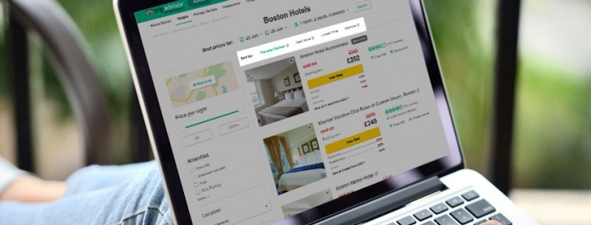
Introduction
A problem that you and me will have

Slide 3

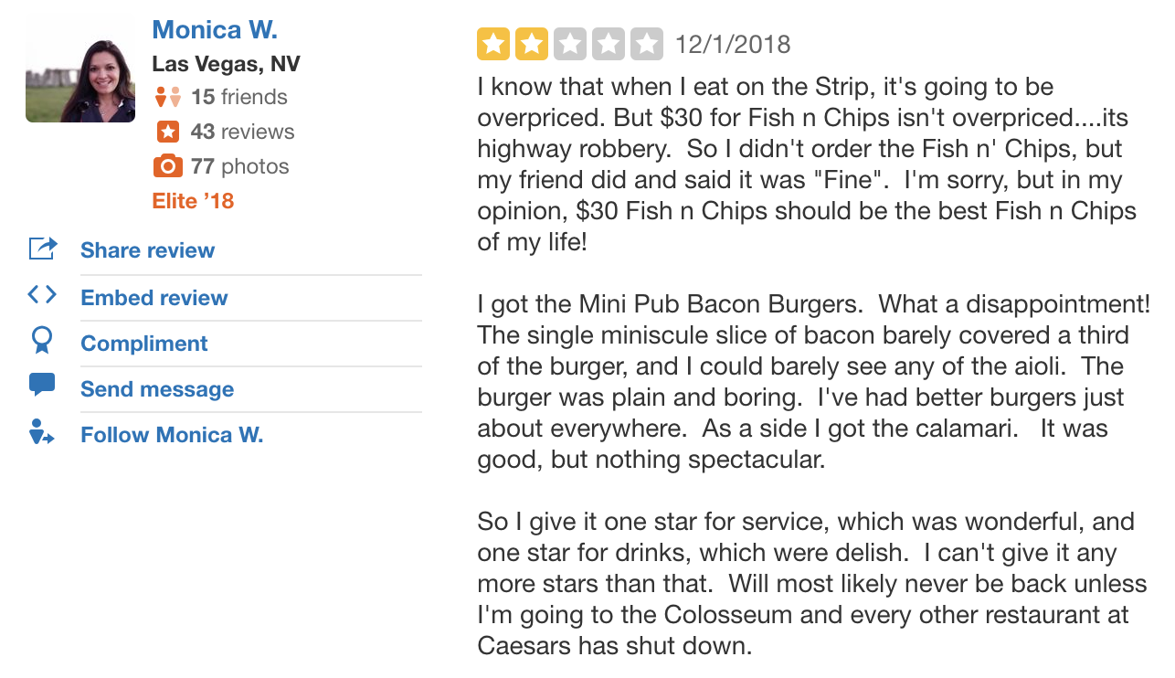
Introduction
Businesses have a larger incentive to analyse review data
For customers
For businesses

Slide 4

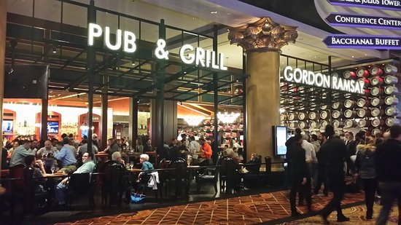
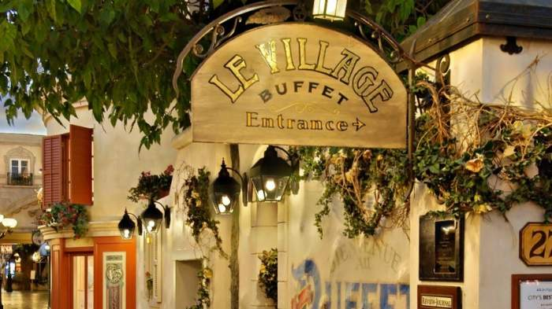
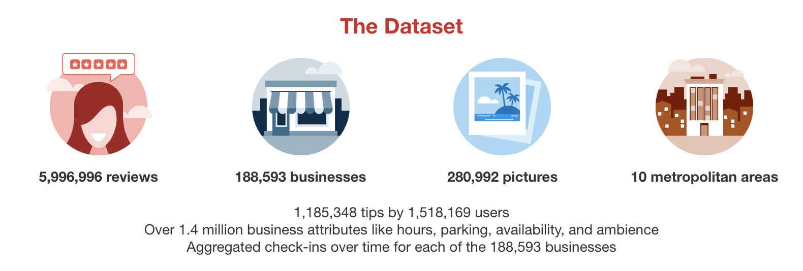
Data Availability
Select restaurants from Yelp dataset with sufficient reviews
Gordon Ramsay Pub & Grill
Le Village buffet
English club restaurant
2,879 observations
Average rating > 3
French-styled buffet
2,246 observations
Average rating =< 3
~70 restaurants with reviews > 2,000
~65 located in Las Vegas
Our objective is to generate useful information for owners (e.g. Mr. Ramsay) to improve their restaurants

Slide 5
Hypotheses & Implications
We generated six initial hypothesis to guide our text analysis
1
Specific elements that most customers will be evaluating at
Advise the business focus on specific areas to enhance customer experience
2
Specific elements (e.g. services, food) that are related to low or high rating
Advice the business to put resources for the improvement or presentation of such elements
3
Specific problems that will mentioned in majority negative reviews
Advise the business to solve the significant problems
4
Specific dishes that mentioned frequently in positive reviews.
Advise the business to put the photo upfront and advice customers what to order
5
High review frequency or good rating in specific holiday.
Advise the business to focus on particular period
6
Specific groups of customers being attracted to the restaurant (e.g. couples, families)
Allow the business to know the target customers and offer targeted menu

Slide 6

Overview of Analysis
Three analyses covered in our project to identify meaningful data from reviews
1
2
3
Opinion Mining
Time-period Analysis
Classification
problems, dishes, elements for good / bad reviews
customer groups, feedback changes in special occasions
elements that customers evaluating on

Slide 7
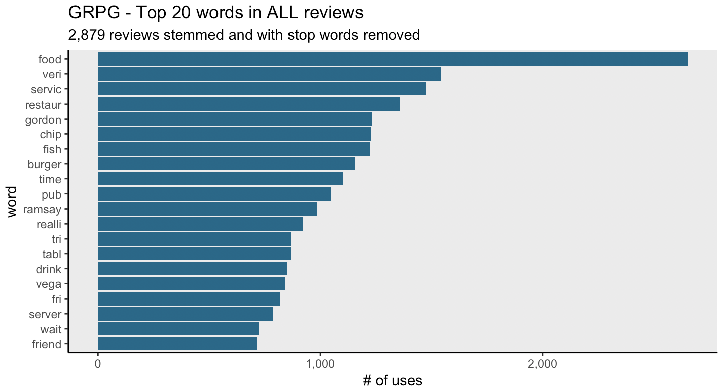
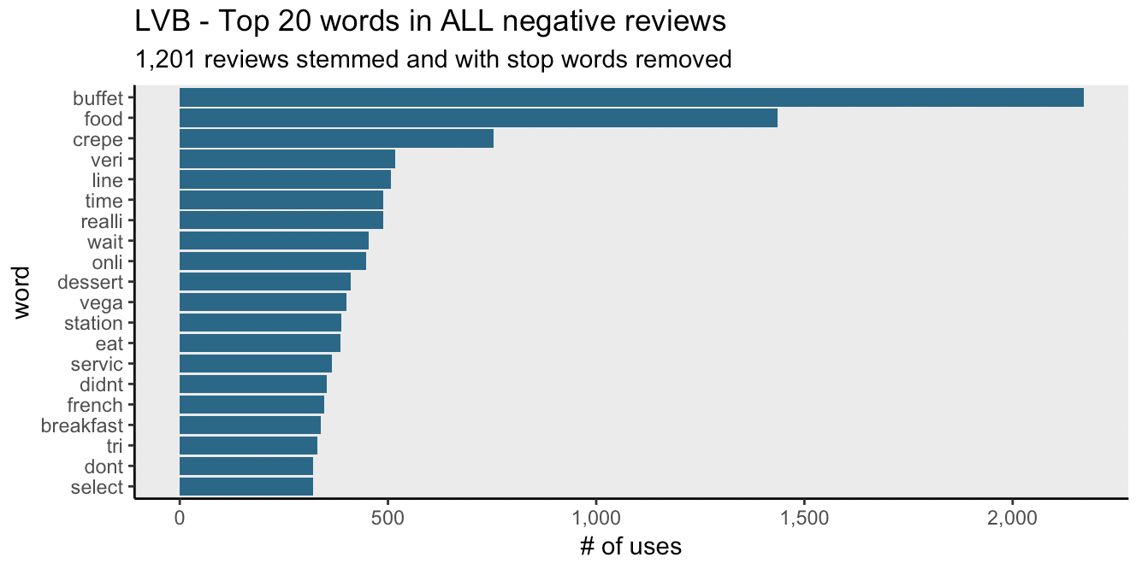
1 – Opinion Mining
Classify generic, adverb and name related words to meaningless e.g. food, very, gordon
Find the most frequently mentioned words in different subset
Meaningful words:
“servic” (service), “chip”, “fish”, “burger”, “time”, “tabl” (table), “drink”, “fri” (fries), “server”
Meaningful words:
“crepe”, “line”, “time”, “wait”, “dessert”, “breakfast”

Slide 8
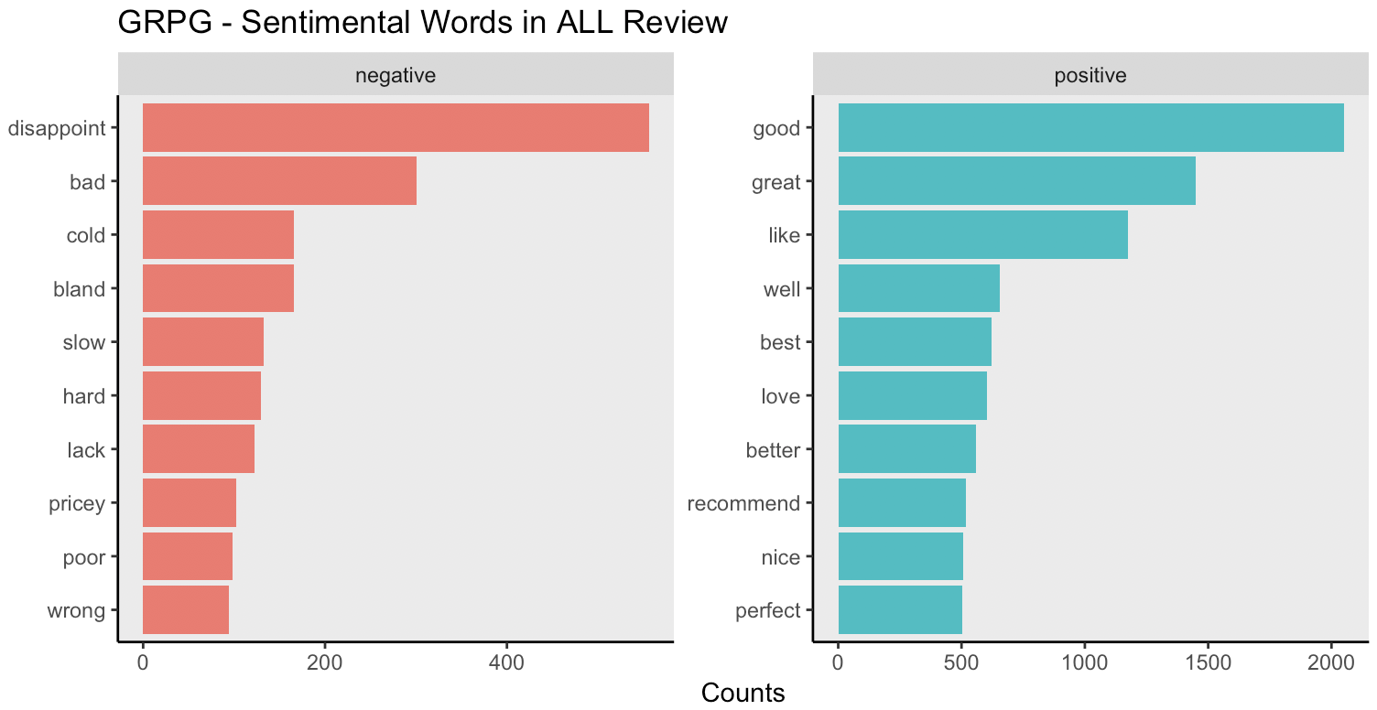
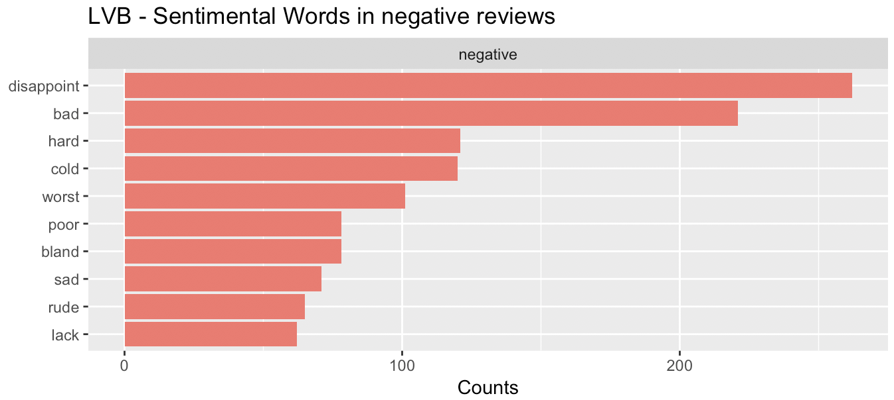
1 – Opinion Mining
Identify key sentimental words
Find the most frequently mentioned words in different subset
Summarize commonly used sentimental words that contribute to high and (or) negative reviews

Slide 9
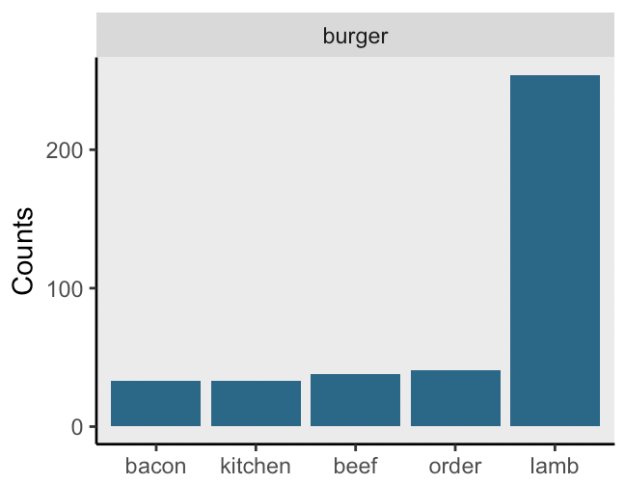
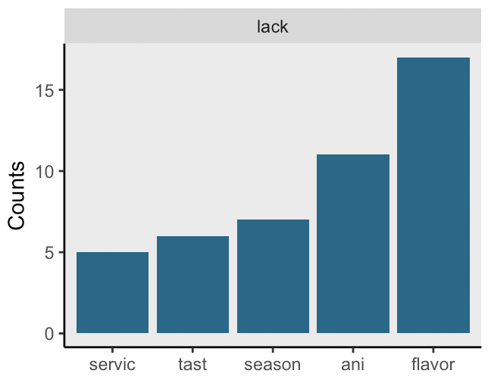
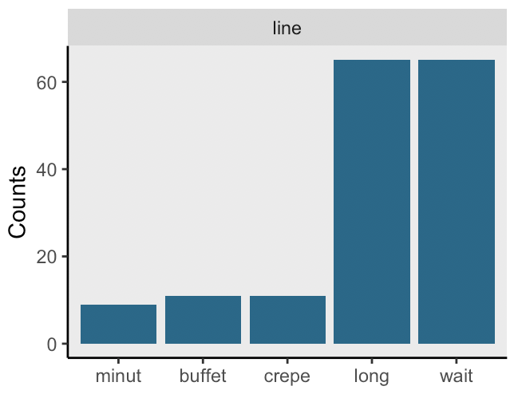
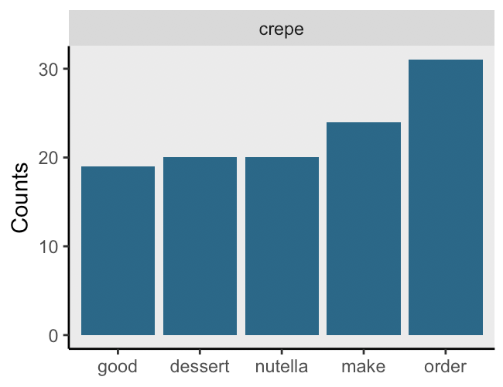
1 – Opinion Mining
Bigrams to identify implications based on significant data
Find the most frequently mentioned words in different subset
GRPG
Summarize commonly used sentimental words that contribute to high and (or) negative reviews
LVB
Extract bigrams from the reviews and filter based on the objects or the sentimental words

Slide 10
2 – Time-period Analysis
Do people rate higher during festival period?
Original data
Festival Data
Compare the average rating
Rate of negative review (stars <= 3) | Festival Data | Original Data
GRPG | 0.56 | 0.47
LVB | 0.60 | 0.53

Slide 11
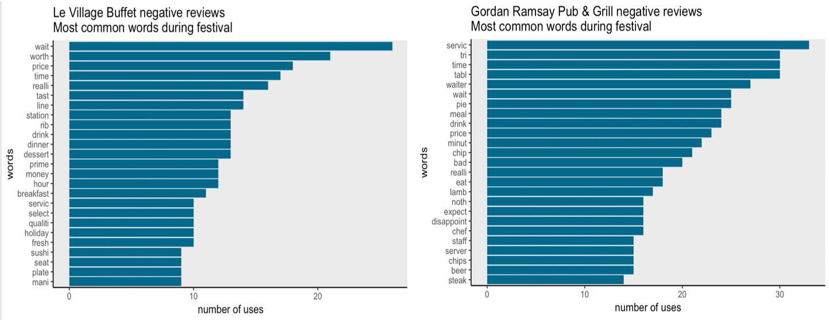
2 – Time-period Analysis
Why?? -- Words that are frequently mentioned in negative reviews during festival period.

Slide 12
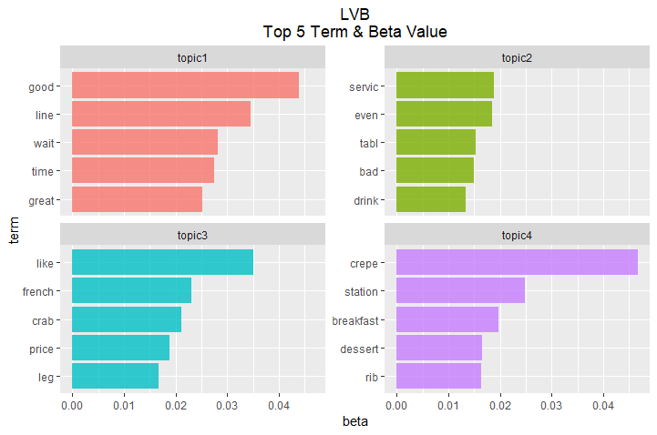
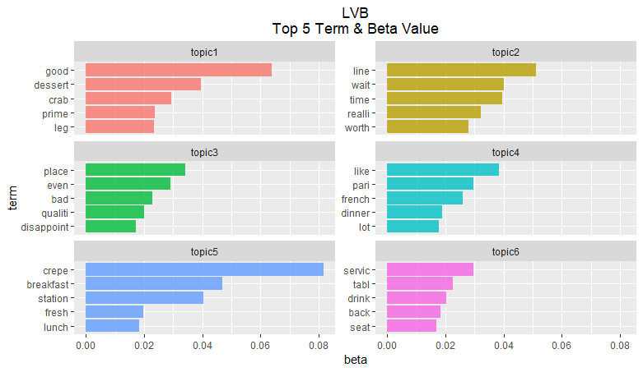
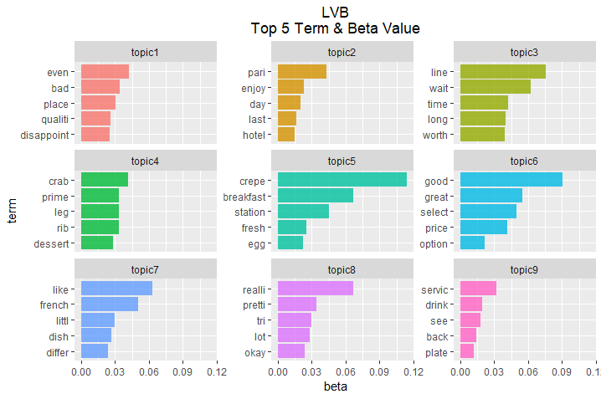
3 – Classification
Unsupervised Machine Learning to classify review content
Data Pre-processing
Clean data and exclude stopwords
Create corpus
Generate Document-term Matrix (DTM)
Decide Topic Number
Fit LDA model
Calculate beta value
Observe top terms
Try different numbers of topics
Select the optimal number
Analyze results

Slide 13
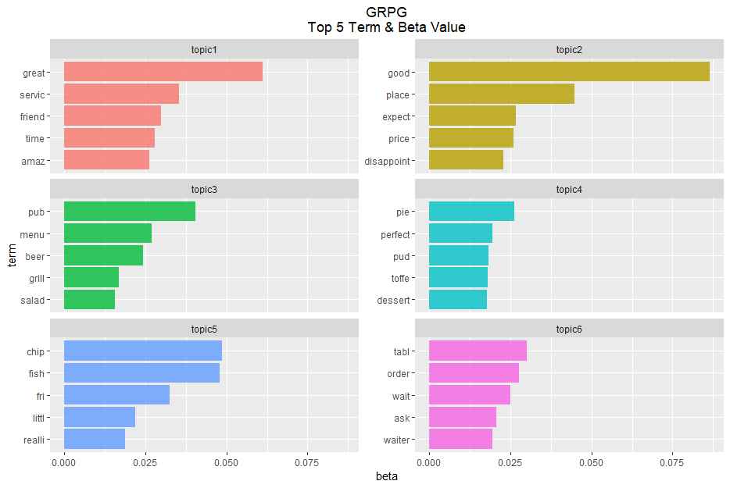
3 – Classification
Unsupervised Machine Learning to classify review content
Define Topics
Example.
“Table, Order, Wait, Ask, Waiter” in Topic 6
→ About “Taking orders”
Service
Expectation
Sentiment Analysis
Calculate posterior probability
Calculate sentiment score of each review
Removing outliers
Food & Drinks
Desserts
Plot the results
Snacks
Order Taking

Slide 14
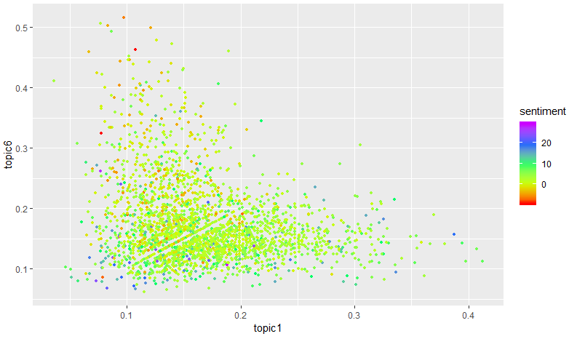
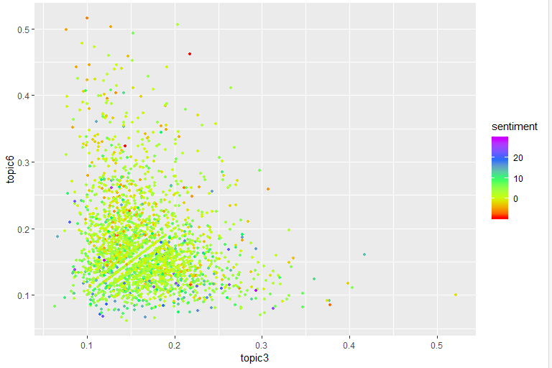
3 – Classification
Unsupervised Machine Learning to classify review content
GRPG
Sentiment Analysis of 2 Topics
Sentiment Analysis
Calculate posterior probability
Calculate sentiment score of each review
Removing outliers
Order Taking
Order Taking
Conclusion
Order taking process can be improved while the service provided overall satisfies the customers.
Order taking process, in terms of the waiting time and waiter performance, are a weak point to GRPG.
Service
Food & Drinks
14

Slide 15
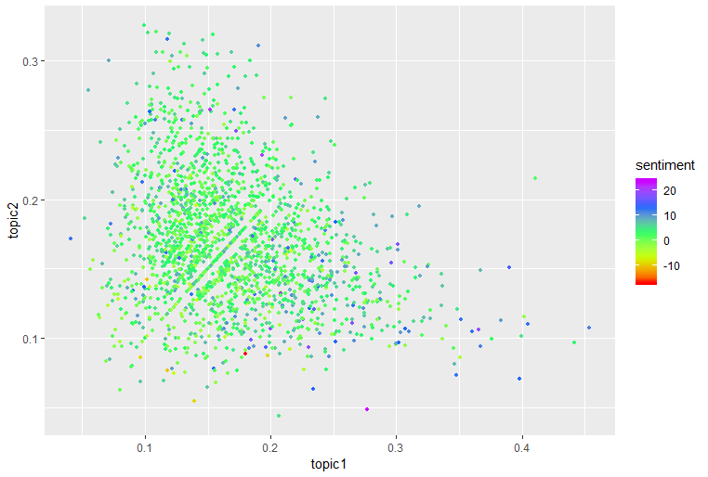
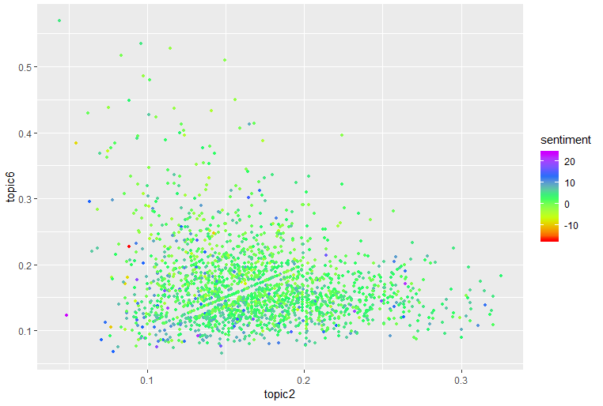
3 – Classification
Unsupervised Machine Learning to classify review content
LVB
Sentiment Analysis of 2 Topics
Conclusion
there is no obvious weak points for LVB among food, serving and waiting time.
Service
Service
Limitations
Contents highly similar
Topic definition is subjective
Not every 2 topics have relation with each other
Food & Desserts
Waiting Time
15
15

Slide 16
Conclusion
Key findings
Opinion Mining
Time-period Analysis
Classification
Specific problems mentioned in majority negative reviews
Specific dishes mentioned frequently in positive reviews.
Elements that most customers will be evaluating at
Good rating in specific holiday
Lamb burger signature dishes for GRPG
LVB to focus on queuing in front of food stations
6 important topics for restaurants
bad rating are more frequent

Slide 17
Group 5
Becky | Lawrence | Tony
Intelligence from reviews: the fundamental for 5 star restaurants

Slide 18
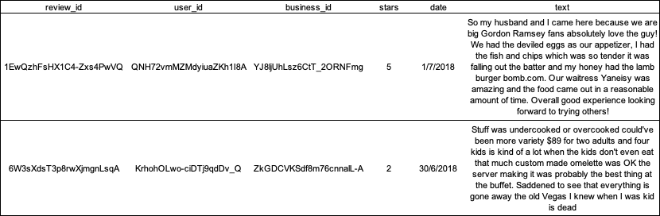
Appendix: Data collection and pre-processing manipulation
To prepare the review data for further analysis, our team applied the ​tm package to purify the text. Firstly, we used the ​tolower() function to convert all text into lowercase and str_replace_all() from ​stringr package to get rid of strange unicode in the text such as é, ñ and <U+00a0>. Then, we removed the punctuation using ​removePunctuation()​, removed stopwords using ​removeWords() with the list from ​SnowballC package, stemmed the document using ​stemDocument()​.

Slide 19

Appendix: 2 – Time-period Analysis: Limitation
Celebrating the Festival
People who send a review during a festival date
Other reasons

Slide 20

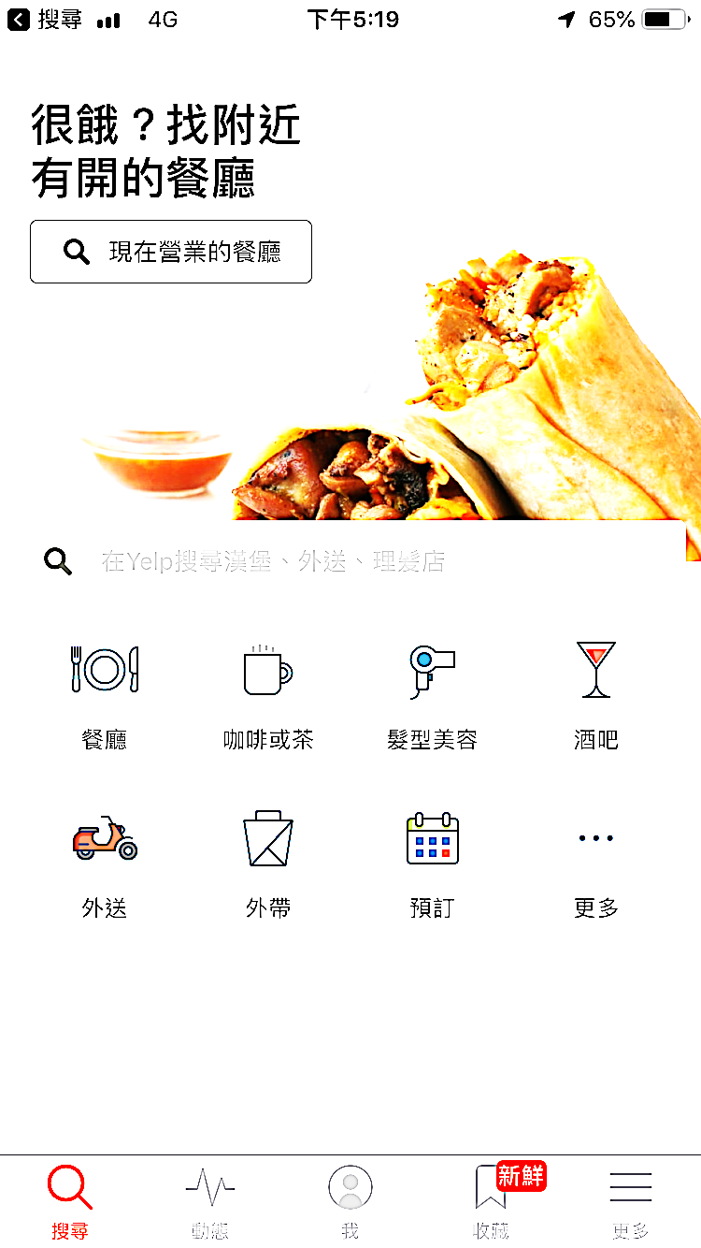

Appendix: 2 – Time-period Analysis: Limitation
What can we do if we reach this kind of data?
1
Compare review during festival period between restaurants
2
Find out the most popular restaurant during specific festival.
Celebrating Christmas?
Top 15 restaurant for celebrating Christmas
3
Show me
Pop out recommendation during festival period

Slide 21
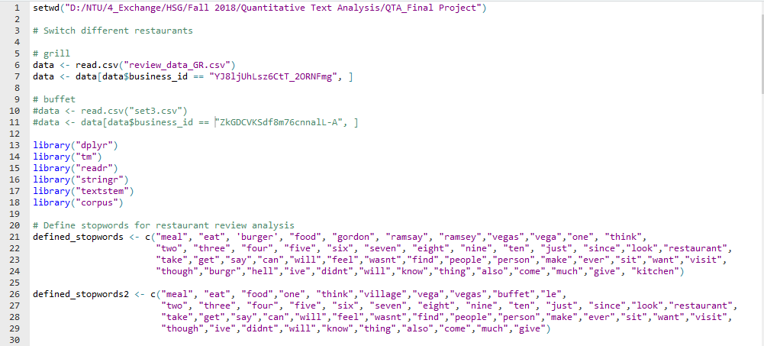
Appendix: Data collection and pre-processing manipulation
Classification

Slide 22
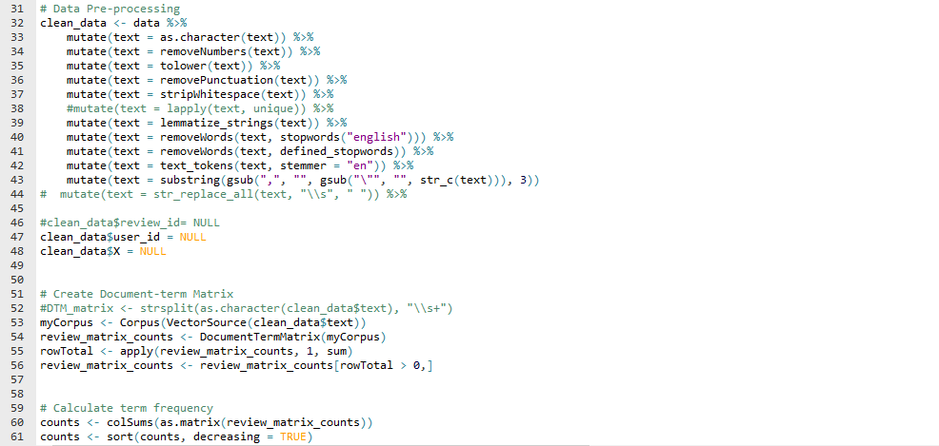
Appendix: Data collection and pre-processing manipulation
Classification

Slide 23
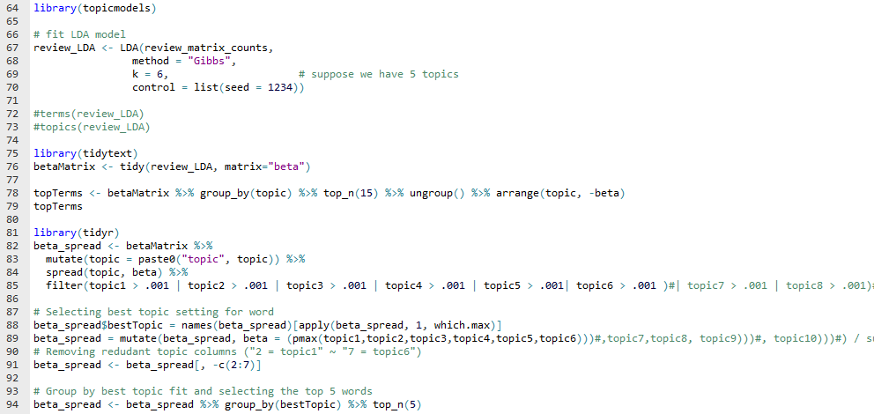
Appendix: Data collection and pre-processing manipulation
Classification

Slide 24
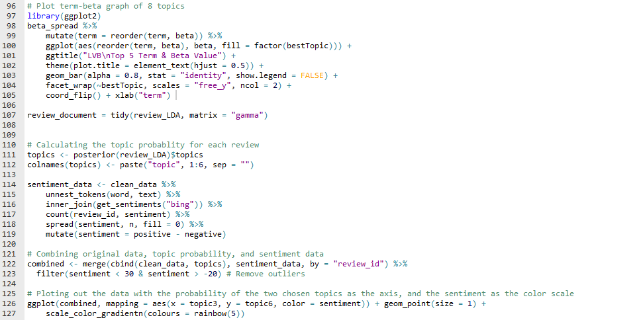
Appendix: Data collection and pre-processing manipulation
Classification

Slide 25
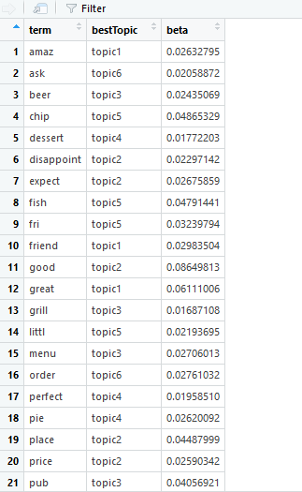
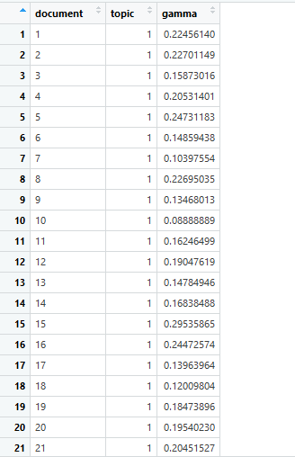
Appendix: Data collection and pre-processing manipulation
Classification
Beta Spread
Review document

Slide 26
Appendix: Hypotheses checklist
We generated six initial hypothesis to guide our text analysis
1
Specific elements that most customers will be evaluating at
The classification analysis shows 6 important topics for restaurants which are main themes for all reviews.
2
Specific elements (e.g. services, food) that are related to low or high rating
The analyses adopted are unable to show a clear difference in elements
3
Specific problems that will mentioned in majority negative reviews
With the example for LVB to focus on queuing in front of food stations.
4
Specific dishes that mentioned frequently in positive reviews.
With lamb burger as the signature dishes for GRPG and crepe for LVB.
5
High review frequency or good rating in specific holiday.
Our analysis shows that bad rating are more frequent in both restaurants
6
Specific groups of customers being attracted to the restaurant (e.g. couples, families)
The analyses adopted are unable to capture this hypothesis.

